Slide 1
Communications-Denied Maritime Navigational Aid
Andrew West, Jack Chynoweth, Leo Schofield, Demetrius Zaibo

Slide 2
Project Execution Plan

Slide 3
Research Question and Objectives
Can a MEMS-based IMU be used to create a maritime navigational aid, for use in a communication denied environment, with comparable accuracy to other contemporary navigation systems?
Navigation System Evaluation
INS Error Sources
Noise Correction
Software Implementation
User Interface & Metrics

Slide 4
Stakeholders
University of Plymouth
Team Members
UTC Aerospace (Silicon Sensing)
A person, group or organization that has interest or concern in an organization. Stakeholders can affect or be affected by the organization's actions, objectives and policies.
http://www.businessdictionary.com/definition/stakeholder.html

Slide 5
Role Allocations
 | Finance Officer | Health & Safety | Secretary | Software Manager | Hardware Manager | Communications Representative | Resource Manager
Andrew West | D |  | P | P
Jack Chynoweth | P |  |  |  | D | D | P
Leo Schofield |  | P |  |  | P |  | D
Demetrius Zaibo |  | D | D | D |  | P
P = Primary
D = Deputy

Slide 6
System Requirements – How we decomposed the system
Navigation (INS)
Communications Denied
User Interface & Metric

Slide 7
MoSCoW
Must Have
Should Have
Could Have
Won’t Have

Slide 8
Planning and Mitigation
IP Collaboration Agreement
Risk Assessment
Non-Subjective Definitions
Breakdown Structures

Slide 9
Delivery and Sub-Delivery
Change-logging
Test Cycles
Development Process
Peer Review

Slide 10
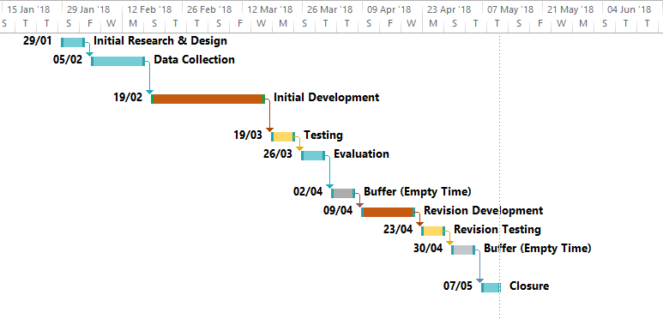
Gantt Chart

Slide 11
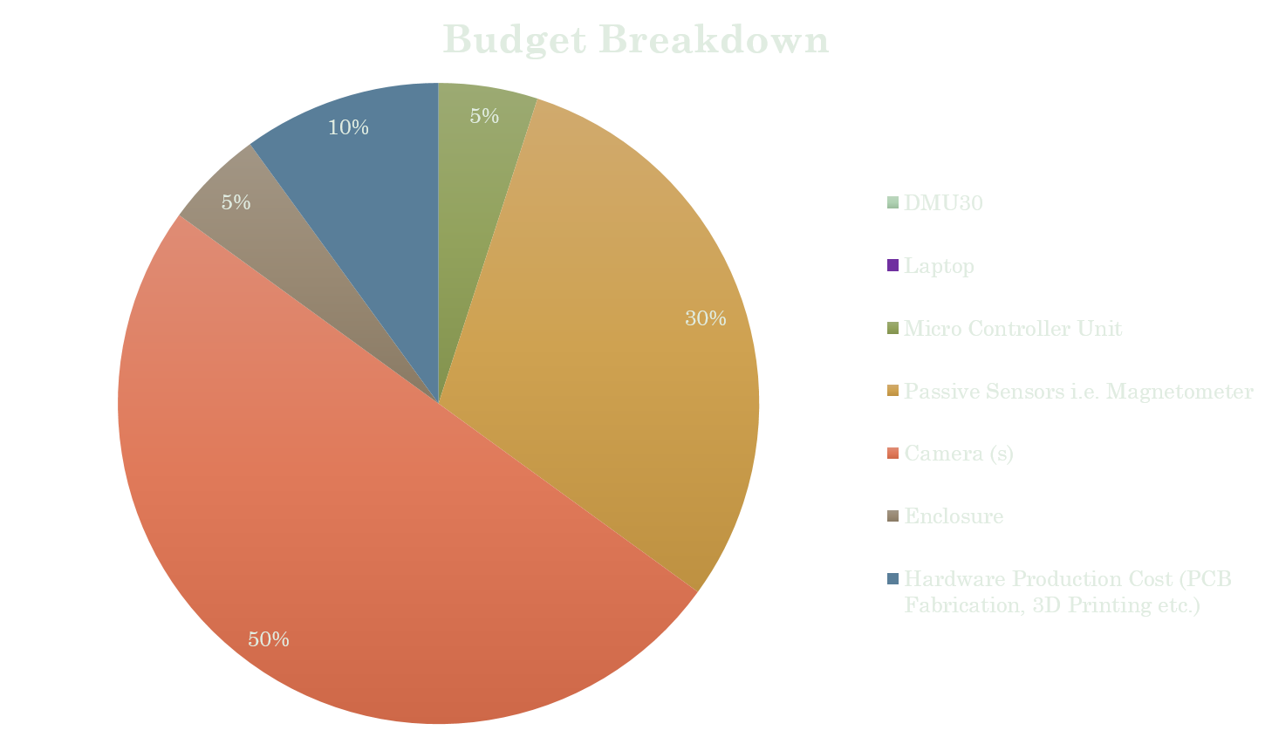
Budget

Slide 12
IP Landscape

Slide 13
Search Algorithm
Inertial Navigation
IMU-based systems
Automated Classical Navigation
Namely celestial
Drift and error correction
Kalman filtering / Allen variance
System use location
Ocean / Marine / Water

Slide 14
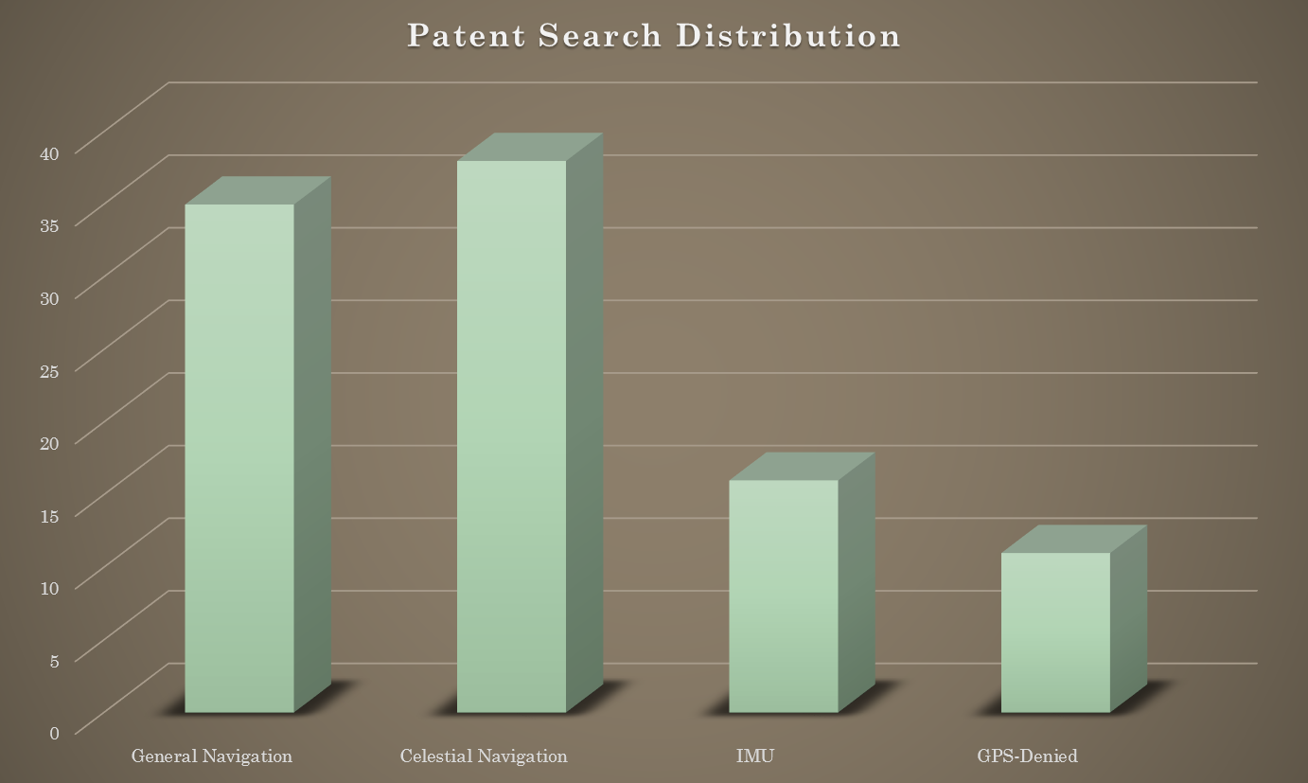
Defining a related patent

Slide 15
Rating Patents
Threat Rating
Scored: 1-5
Enforceability Rating
Status
Scored: 1-5
Generality
Scored: 1-5
Prior Art
Scored: 1-5

Slide 16
Threatening Patents
Methods and apparatus for navigational aiding using celestial object tracking
Method and apparatus for automatic identification of celestial bodies

Slide 17
Key Restrictions
Hardware Constraints
Lens Selection
Number of Cameras
Niche Hardware Setups
Algorithm Constraints
Identifying Celestial Bodies
Celestial Navigation Methods
Data Storage

Slide 18
Questions
?

